Slide 1
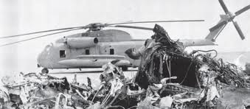
Applied Probability and Simulation to Understand Risk in Operation Eagle Claw
A Case study in the Flaw of Average-Based Decision Making
Notes:
Slide one: Introduce subject and instructor
This case study deals with an application of operational analysis, risk assessment, that was not done but according to a United States Admiral should have been done. We look back to late 1979 when Iranian demonstrators took over the American Embassy.

Slide 2
Overview
Situation: Iran, November 1979, the American Embassy was over run by Iranian revolutionaries who took 52 Americans hostage. In April 1980 U.S. forces attempted a rescue codenamed OPERATION EAGLE. It ended in failure at Desert One due to helicopter failure.
Decision: How many helicopters to take on the mission knowing six were required to lift the rescue team and the hostages?
Objective: Take a sufficient number of helicopters to keep the risk of mission failure due to helicopter failure under given limit (e.g. 5%).
OA Contribution: None in the planning and execution of the operation. OA was engaged in the post mission analysis to investigate on risk assessment.
Notes:
Here is the overview and situation. After five months of captivity, President Carter ordered a rescue attempt of the Americans being held by Iranian forces inside the American Embassy. That attempt failed due to a catastrophic accident that occurred at a desert refueling site called Desert One. The post investigation uncovered several planning challenges but the one we will focus on is the decision on how many helicopters to use in the mission. To lift all the U.S. forces and return with all the hostages a total of six helicopters were required to make the round trip. The issue for the original planning team was how many helicopters to send to account for helicopter failures. As we will see, the planning team just used a form of average-based decision making and did not apply some simple risk assessment tools to give them an assessment of possible overall mission failure due to helicopter reliability.

Slide 3
Situation: Risk Assessment in Operation EAGLE CLAW
Issue 11 of the “Holloway Report” (Operation Eagle Claw’s Planning Evaluation)
RH-53D SEA STALLION Force Size or Risk versus Resources. How many is enough? 6? 8? Or 12?
Calculation based on Expected Value
Historically reliability of each RH-53D SEA STALLION is 75%
Based on expected value 8 helicopter are needed (8 * 0.75 = 6)
Problem:
Expected value decision making
Notes:
Slide 3:
After the Iranian Rescue mission failure, a follow on investigation lead by Admiral Holloway uncovered several challenges to the planning and execution of this operation. His report lead to the establishment of the U.S. Special Operations Command.
Our interest is Issue number 11 from the report: The way the number of RH-53Ds readied for the mission was determined based on an expected value of individual failure. In this case it was 75%. The planners simply solved the equation X * .75 = 6 to determine they needed to start with 8 helicopters. The average based decision method does not take into account the “tails” of probability of success or failure. It places you somewhere in the middle of the chances of succeeding or failing.

Slide 4
OA Distribution: Application of Applied Probability
Assuming that the reliability of each helicopter is independent of each other applied probability gives a calculation for the overall mission success
To limit the risk of failure under 1% due to heli-copter failure 12 helicopter are necessary
Notes:
Slide 4:
Instructor notes:
Explain what a binomial distribution is by using a simple example:
--3 heads out of five coin tosses
--Or in this case 6 or more heads out of how many coin tosses I need for a certain level of success
Discuss independence assumption on each trial and how it this case it is false (helos flying in formation are not independent), but this method still gives one a gross level assessment of risk of failure.
What can be seen is more resources: less risk of failure
Point out the end of a risk curve or S curve: more on that later.

Slide 5
OA Distribution: Simulation Results (Monte Carlo)
The Monte Carlo simulation of the helos as independent events gives even a little bit more pessimistic probabilities for success but are in the same range as the applied probabilities
100 Simulations with 8 Helos:
72/100 Missions Successful
100 Simulations with 11 Helos:
94/100 Missions Successful
Notes:
Slide 5:
Simulation is another approach and can mitigate independence assumption. In this case we simulate the round trip mission and record the number of helos surviving after each mission.
Use point to explain a frequency plot that provide a histogram

Slide 6
What is Proper Risk Assessment?
Risk Assessment is the identification, evaluation, and estimation of the levels of risks involved in a situation.
Risk can include unknown knowledge about the situation, unknown knowledge about the development of the course of action or unknown knowledge about the processes driving the situation.
Historical data analysis, probability theory and simulation are frequently used to quantify risk and bound uncertainity.

Slide 7
Strengths and Weaknesses Risk Assessment
Provides insight into marginal benefit of resources to lessen risk.
The better the historical date base and/or estimates, the better the assessment value.
In many cases, assumes environment in the immediate future will be the same as the immediate past for data consistency.

Slide 8
Summary
Risk analysis is driven by you, the decision maker. You define what is an acceptable risk.
To best utilize your operational analyst to aid in decision making, they need access to you, the decision maker to know about your preferences and to be involved as well in the planning process as during execution.
The operational analyst brings a variety of tools (optimization, simulation, statistics, and assessment skills) to help you with evidence based decision making.

Slide 9
More Detail Follows

Slide 10
Quantifying Risk by exploring variability
Let’s look at a simplified budgeting example
We want to determine the risk of costs over runs in a gas turbine rework facility
Consider: What are sources of highest variability during the budget execution?
Notes:
Slide 10:
Let’s move from the case study to another example of how one can use risk assessmsent. Let’s apply this concept to a budgeting forecast where we are budgeting for rework of 30 gas turbine engines over three months.
Although we will use a rework example, the U.S. Navy uses the same process for understand the risk in budgeting for ship construction.

Slide 11
Gas Turbine Rework Depot Example
LM2500 Arrives
Rework
Parts
No
About
2/3
Repair?
LM2500
Inspected
LM2500
Rework
Yes
About 1/3
LM2500
Repair
LM2500
Shipped
Repair
Parts
Notes:
Slide 11:
Explain flow of work in the rework depot and “cost” centers. Ask seminar where they think the most “cost” variance is. Discuss we expect that to be in the repair shop.

Slide 12
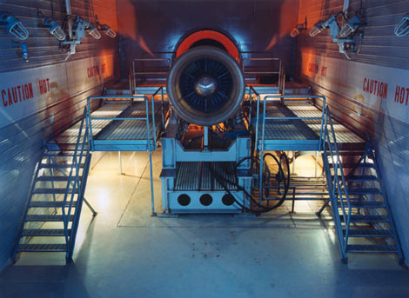
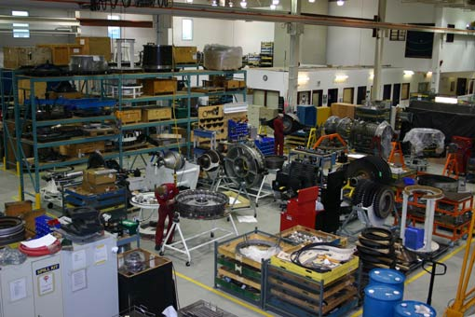
Quantifying Risk by exploring variability
Possible costs (or outlay) categories:
Salaries in each workshop
Supplies
Utilities
Contract Services
Fixed Costs
Each category highly correlated with engine needing repair in addition rework.
Which might have the greatest variability?
Notes:
Slide 12:
Explain where cost can occur in our example:
Salaries in each workshop
Supplies
Utilities
Contract Services
Fixed Costs

Slide 13
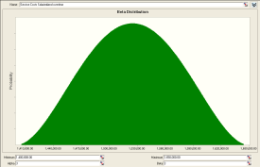
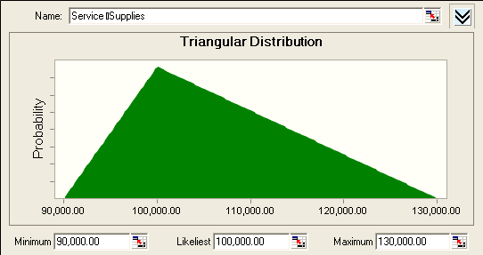
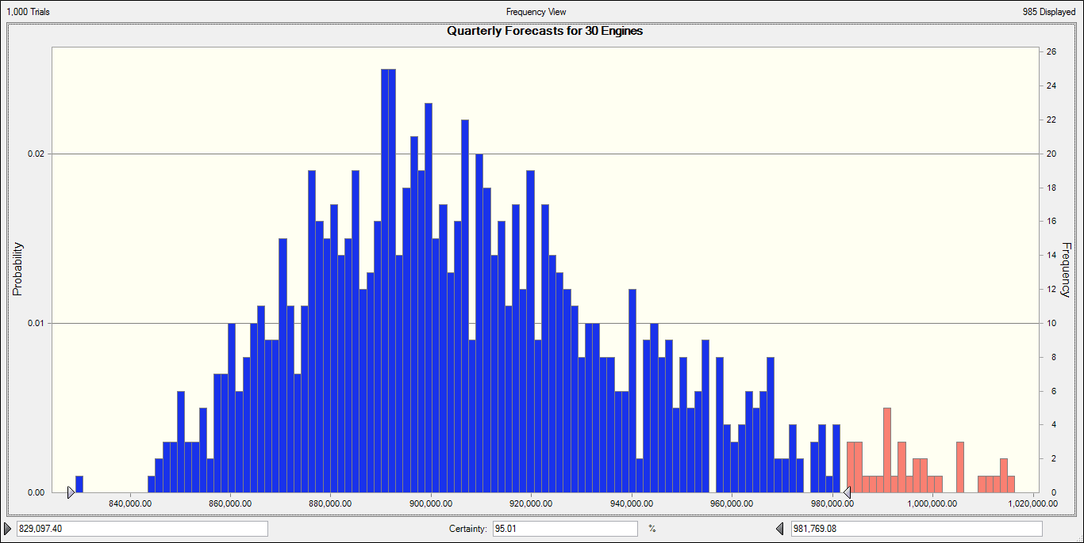
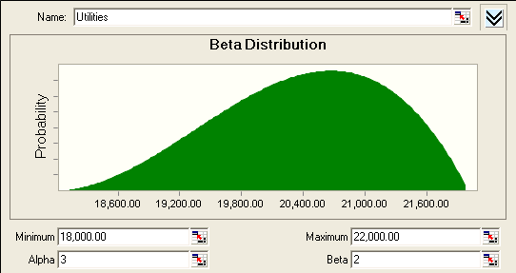
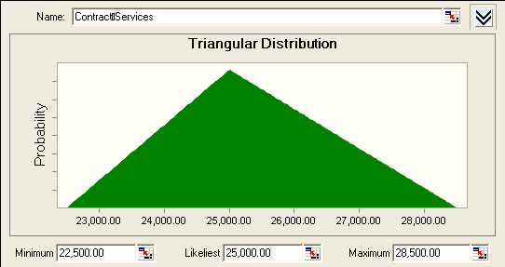
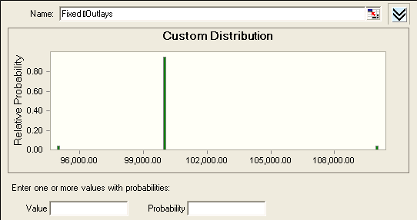
We can build a simulation of our quarterly costs with 30 engines
Labor Costs
Supplies
Utilities
Contracts
Simulation Histogram
Of Quarterly Costs
Fixed Costs
Notes:
Slide 13:
Discuss where we get the data distributions: historical analysis from past cost performance (best), subject matter expert experience (fair), no information (guess). In our example, we use historical data to draw upon to simulate the process. We do this to get a “combined” distribution of total costs. Point out this can be done without simulation if past data for total costs are available.
Point out this picture can be of any process that include variability from each step. For example, recall the U.S. Navy uses this technique for ship cost budgeting. Each input distribution are categories like cost of copper, steal, labor, schedule slippage, etc.

Slide 14
Histogram provides risk in budgeting
Notes:
Slide 14:
Closer look at the histogram of results simulating 1000 quarters of 30 engine repairs. Explain points on histogram

Slide 15
Histogram provides risk in budgeting
5% Risk
of cost
over-run
if budget
is about
$980K
Notes:
Slide 15:
The histogram allows us to conduct “what ifs”. What if I budget $980K for the coming quarter to conduct 30 engine reworks? Then, based on my historical data and simulation, I’ll have about a 5% chance of being under budgeted.

Slide 16
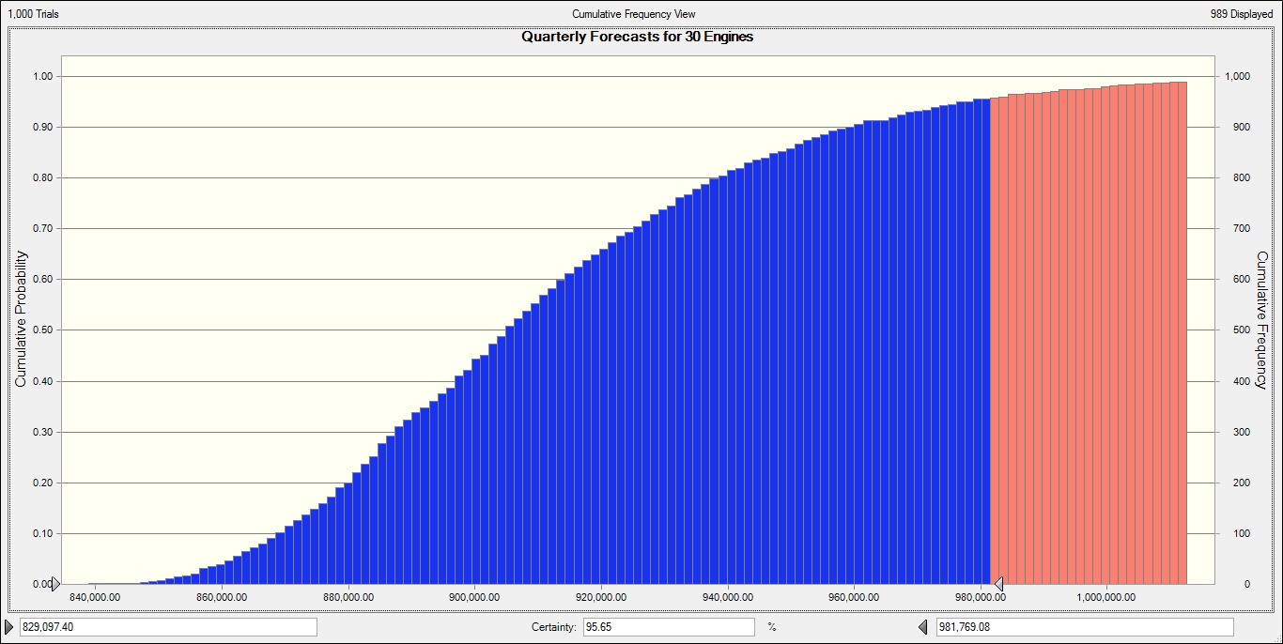
Risk “S” Curve is Cumulative Histogram
Adding frequency from Histogram on top of each other
Notes:
Slide 16:
Risk analysts like to convert the frequency results into S curves for ease of reading. Explain a S curve is just the cumulative distribution.

Slide 17
The Budget Risk “S” Curve
95%
Notes:
Slide 17:
With an “S” curve, I can read my risk of being on or under budget directly from the y axis. What if we are only given $900K to rework the 30 engines? What are our chances we will be over budget? Ask the seminar what we can do about it. Fewer engines?

Slide 18
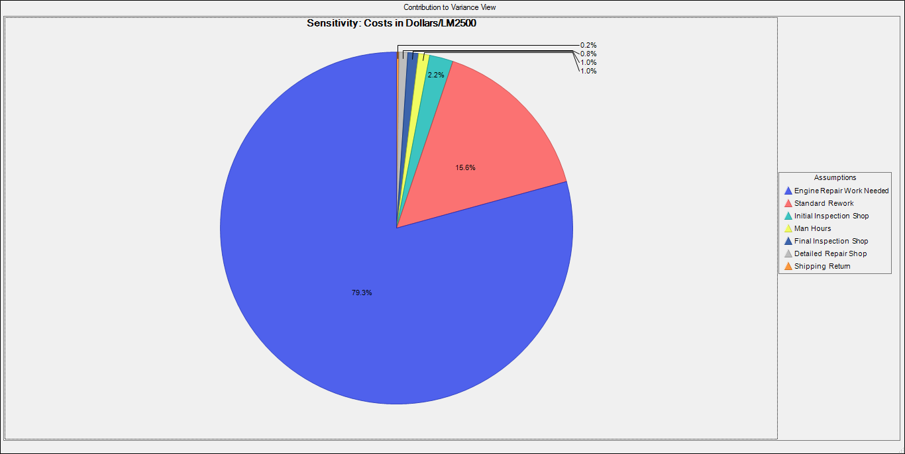
Contributions to variance (risk)
Repair Labor Costs are largest contributor to variance followed by Standard Rework Labor Costs
Notes:
Slide 18:
Simulation results can also provide where your variability comes from. In this chart, we see the most variability comes from the repair shop labor costs (as expected since we don’t know in advance what repairs are needed). The second most variability (almost 16%) comes from the standard rework shop. Ask the seminar if this makes sense, or do we need to look at the reasons.

Slide 19
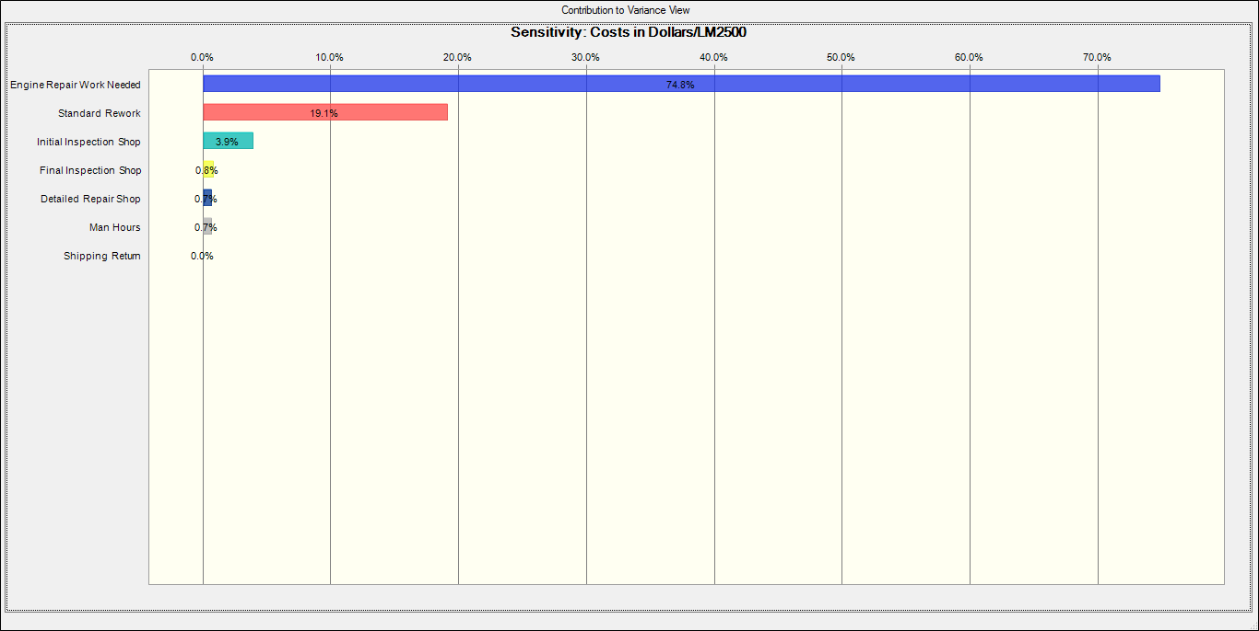
Contributions to variance (risk) “Tornado Chart”
Repair Labor Costs are largest contributor to variance followed by Standard Rework Labor Costs
Notes:
Slide 19:
Contributions to variance are frequently shown as tornado charts. They provide the same information in a bar format and are preferred by many decision makers.

Slide 20
Risk Assessment on Costs: A Cost Probability Distribution
COMBINED COST MODELING AND TECHNICAL RISK
Cost = a + bX^{c}
COST MODELING UNCERTAINTY
Cost
Estimate
Historical data point
$
Cost estimating relationship
TECHNICAL RISK
Standard percent error bounds
Cost Driver (Weight)
Input
variable
Notes:
Slide 20:
The concept of variance and risk can be found in many analytical methods. This is a cost estimation slide using regression to estimate future program costs, and you can see the variance of the estimates come from variance of the input information.

Slide 21
Black Swans and Surprise
What are Black Swans?
Can we prepare for the unknown?
Can we anticipate surprise?
Resilience
Flexible
Agile
Innovative
Notes:
Slide 21:
But, what about preparing for events we don’t plan for or anticipate? We cannot analyze or simulate that which we don’t anticipate. Discuss concept of Black Swains and surprise, red teaming, and response. Allow seminar to bring up examples.

Slide 22
Conclusions
Risk is a component of uncertainty and variability
CAREFUL: Average Based Decision Making!
Notes:
Slide 22:
Conclusions. Review major points on uncertainty and variability.

Slide 23
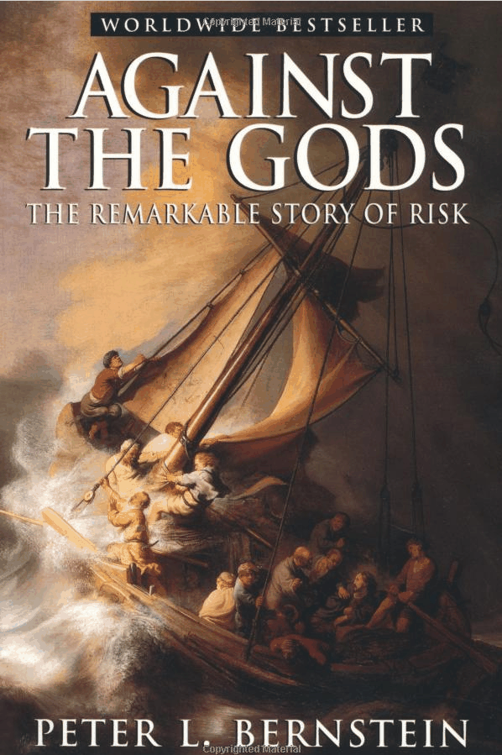
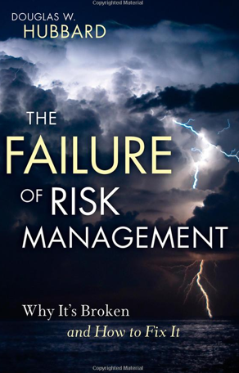
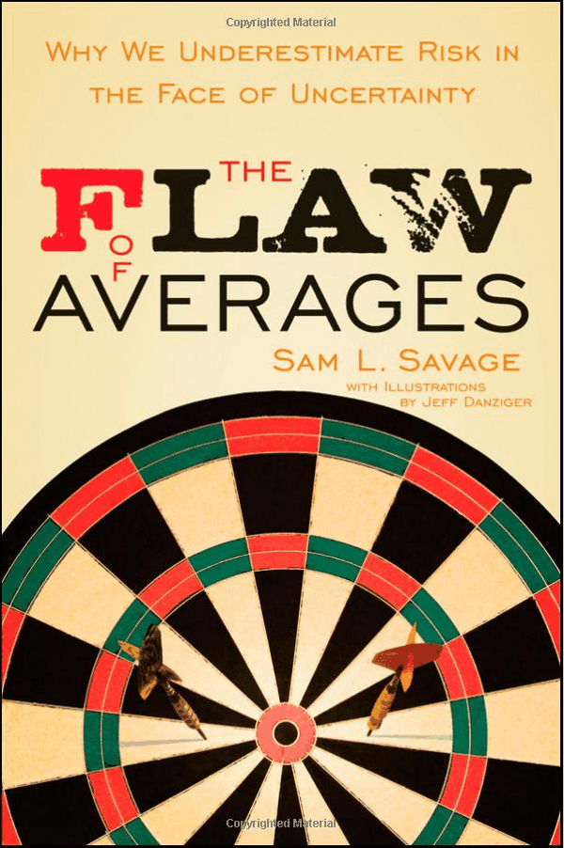
Recommended Reading
Notes:
Slide 23:
Recommended readings:
Against the Gods
Failure of Risk Management
The Flaws of Averages.

